Slide 1
Classical Management Thoughts

Slide 2
Learning Outcome
Students will understand classical management thoughts .
Students will learn the important schools of management & their contributions.

Slide 3
MCQ
Scientific Management were more concerned with the problems at the__________ Levels.
Higher levels
Middle
Operating
None

Slide 4
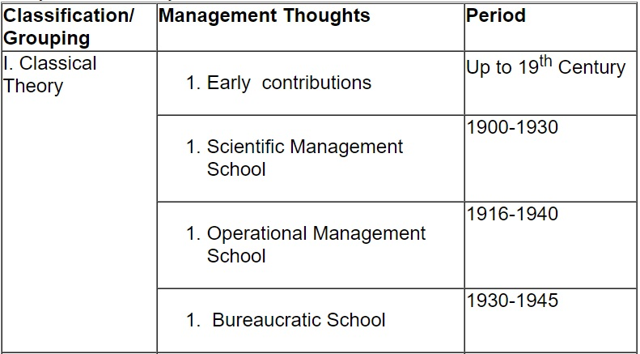
SCHOOLS OF MANAGEMENT THOUGHT

Slide 5
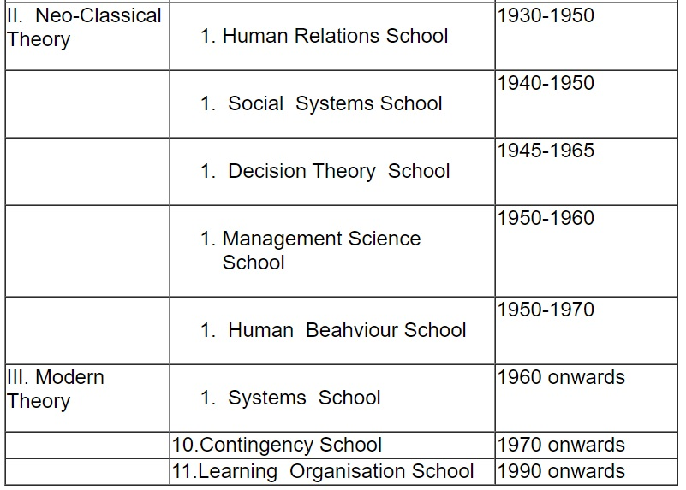
SCHOOLS OF MANAGEMENT THOUGHT

Slide 6
SCHOOLS OF MANAGEMENT THOUGHT
Classical Theory
Early Contributions
The concept of organisation and administration existed in Egypt in 1300 B.C.
Kautilya gave sound principles of state administration as early as in 320 B.C.
Roman Catholic Church introduced the concept of staff personnel in Church administration, which was further carried on by military organisations.
In the 16th century, Machiavelli wrote ‘The Prince’ in an attempt to gain favour with the ruler of an Italian city state and described the way that a good prince or leader should act.

Slide 7
SCHOOLS OF MANAGEMENT THOUGHT
These contributions provided some insights about how resources could be utilized more effectively. However, these contributions were outside the field of business and other economic organisations.
Later in the Age of Enlightenment and Renaissance, change of societal value, human worth and individual knowledge, ability, skill and accomplishment were acknowledged, but these alone were not enough to be a good manager.
Industrialism and the factory system of the early 19th century saw the use of management skills, assembly line operation and costing systems.

Slide 8
SCHOOLS OF MANAGEMENT THOUGHT
Scientific Management School
Frederick Winslow Taylor (1856-1915) is considered to be the father of ‘Scientific Management’. Subsequently, he was supported by Henry Gantt, George Berth, Edward Felen, Lillian Gilberth and Harrington Emerson.
Four basic parts of a series of ideas developed by Taylor are as under:
(i) Each person’s job should be broken down into elements and a scientific way to perform each element should be determined;

Slide 9
SCHOOLS OF MANAGEMENT THOUGHT
(ii) Workers should be scientifically selected and trained to do the work in the designed and trained manner;
(iii) There should be good cooperation between management and workers so that tasks are performed in the designed manner;
(iv) There should be a division of labour between managers and workers. Managers should take over the work of supervising and setting up instructions and designing the work and the workers should be free to perform the work themselves.
The scientific management provides a logical framework for the analysis of problems.

Slide 10
SCHOOLS OF MANAGEMENT THOUGHT
Operational Management School
Henry Fayol (1841-1925), a French industrialist is the chief architect and father of the ‘Operational Management Theory’.
He concentrated on the role that managers should perform as planners, organizers and controllers.
He was of the opinion that managers needed basic principles upon which to operate.
He propounded fourteen ‘Principles of Management’,
Henry Fayol was of the opinion that the workers are generally lazy in nature, especially when they work in groups. Discipline is very essential for getting the work done. They can be motivated by the incentive of higher wages for more work or better work.

Slide 11
SCHOOLS OF MANAGEMENT THOUGHT
Bureaucratic School
Max Weber, a German Sociologist, introduced many of the theories of the Bureaucratic School.
Weber viewed bureaucracy as " the most efficient form that could be used most effectively for complex organisations - business , government , military , for example - arising out of the needs of modern society ."
According to Weber the major characteristics of bureaucracy are:
A well defined hierarchy :All positions within a bureaucracy are structured in a way permitting the higher positions to supervise and control the lower positions.

Slide 12
SCHOOLS OF MANAGEMENT THOUGHT
2. Division of labor and specialization is done .
3. All organizational activities are streamlined in a way that standard operating procedures are developed to provide certainty and facilitate coordination.
4. Impersonal relationships between managers and employees so that the managers will be free to take rational decisions rather than one influenced by favoritism and personal prejudice.

Slide 13
SCHOOLS OF MANAGEMENT THOUGHT
5. Competence is the basis for all decisions made in hiring, job assignments, and promotions. This would encourage ability and merit as the most important characteristics of a bureaucratic organization.
6. Records :Weber felt it is absolutely essential for a bureaucracy to maintain complete files regarding all its activities. This necessitates an accurate organizational "memory" where accurate and complete documents will be available concerning all bureaucratic actions and decisions.

Slide 14
MCQ
The Concept of ‘Scientific Management’ was introduced by:
Henry Fayol
Hebert Simon
F.W. Taylor
Peter Drucke

Slide 15
Thank You

